Slide 1
CS Online Judge – User Guidance
CS3334 - Data Structures

Slide 2
Access
http://acm.cs.cityu.edu.hk/oj2/
CSLab VPN is required
automatic settled on all CS Lab computers
CSLab VPN connection: http://cslab.cs.cityu.edu.hk/services/cslab-vpn
user account
Need activation your account
account activation email will be sent to your registration email
contact TA if you have not received email
(provide your student id and email address)

Slide 3
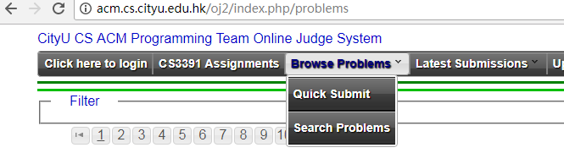
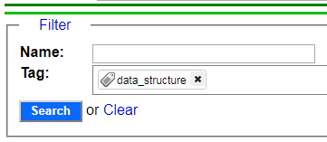
Search Problems
Browse Problems
or use problem id: http://acm.cs.cityu.edu.hk/oj2/index.php/p/31
Search Problems
tag ‘data_structure’

Slide 4
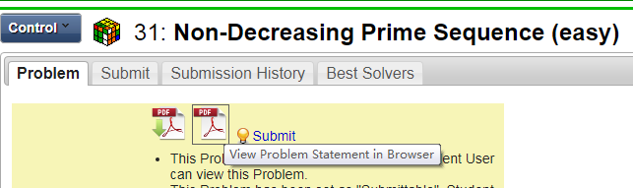
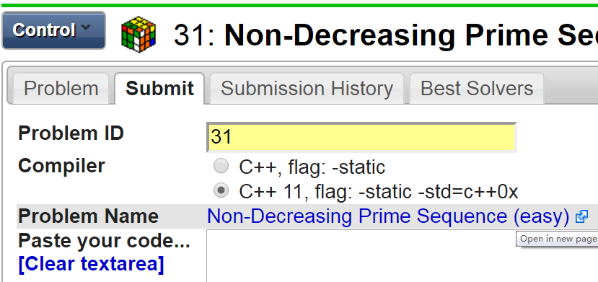
Submit Code
Check Problem Statement
Submit
compiler
paste code

Slide 5
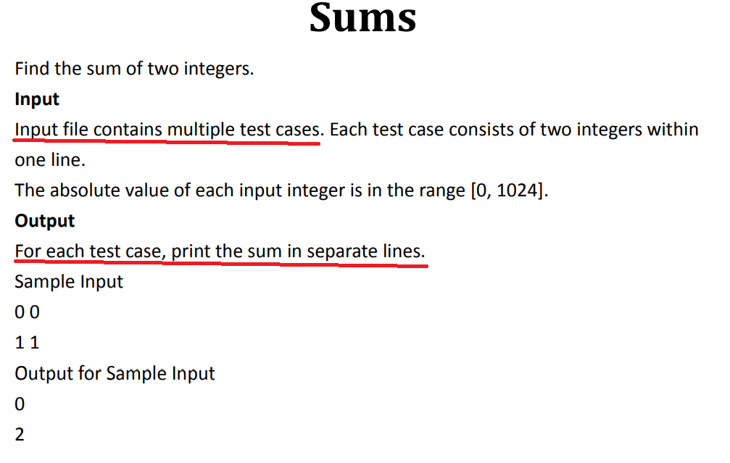
example problem

Slide 6
Input/Output
//example
#include <iostream>
#include <sstream>
#include <string>
using namespace std;
int main(){
string inputstr, outputstr;
cin >> inputstr;
outputstr = inputstr + " Hello";
cout << outputstr << endl;
return 0;
}
//read line-by-line
string linestr;
while ( getline(cin, linestr) )
//read from string
string input = “Hello World";
stringstream myStream(input);
myStream >> str1 >> str2;
Note: space and line breaks will be automatically ignored when reading.

Slide 7
Input/Output
End of Input
while (cin >> str){
// output result
}
Output Format (check problem statement)
for each test case, output the result in one line
while (cin >> caseinput1 >> caseinput2)
cout << caseinput1 + caseinput2 << endl;

Slide 8
Verdict Information
In Queue (QU): your submission code is in the queue, to be compiled.
Compile Error (CE): The server could not compile your submission code. Of course, warning messages are not error messages.
mostly it is caused by syntax errors:
$ variable not defined,
$ variable type not match,
$ need include library
Accepted (AC): OK! Your program is correct!
Presentation Error (PE): Your program outputs are correct but are not presented in the correct way.
Check for spaces line breaks, ‘ ’, ‘\n’, ‘comma’...
Notes:
https://uva.onlinejudge.org/index.php?option=com_content&task=view&id=16&Itemid=31

Slide 9
Verdict Information
Wrong Answer (WA): output is not correct.
$input format,
$special case, any tricky test case?
Runtime Error (RE): Your program failed during the execution.
$ index overflow, a[-1], a[n+1].
$ Stack/memory overflow, endless recursions, self call
Time Limit Exceeded (TLE): Your program is not finished in required time.{time complexity, infinite loop, waiting for input,}
Memory Limit Exceeded (MLE): Your program tried to use more memory than allowed.
static memory (array size) + memory for stack/queue during execution
Output Limit Exceeded (OLE): Your program output too much than expected. {infinite loop}
Notes:
https://uva.onlinejudge.org/index.php?option=com_content&task=view&id=16&Itemid=31

